Slide 1
Procurement Under FEMA Awards Requirements for Recipients and Subrecipients When Procuring Services and Supplies with Funding under Stafford Act Grant Programs
Franklin Ayetin, attorney advisor
Procurement disaster Assistance team (Pdat)
DR-4335-VI; DR-4340-VI
MARCH 2018
Notes:
(1) Provide a brief introduction of the presenter’s background

Slide 2
Agenda
Introductory Remarks
Terminology and Key Players
Background
Procurement Standards for States
Other Considerations for State Procurements
Notes:
Provide an overview of the agenda, timing for each, anticipated breaks.
Please ask questions as they arise during the presentation—there is no need to wait until the end to ask them.

Slide 3
Rules of the Road
Please ask questions as they arise during the presentation—there is no need to wait until the end to ask them.
This presentation (including the slides and any oral information conveyed) provides general information about the procurement requirements applicable to Stafford Act grants and is not intended to be, nor should it be considered as, legal advice.
For example, some slides may omit or only summarize certain requirements set forth in the regulations.
You should not act or rely on information contained in our presentation (written or oral) without seeking the advice of your own attorney.
Notes:
It is not intended to be nor should it be considered as legal advice.
It is also not meant to be an all-encompassing, detailed explanation of every and all requirements. For example, some slides may omit or only summarize certain standards set forth in the regulations.
In addition, there are a lot of other laws, regulations, and executive orders that will “flow down” to a non-Federal entity’s procurements—this presentation does not discuss them.
One example is the Clean Air Act.

Slide 4

Purpose
This presentation is intended to provide a high level, general overview of the Federal procurement standards applicable to disaster assistance awards under the Stafford Act.
We don’t expect you to become experts after this presentation; however, you should be able to recognize the basic concepts and issues necessary to successfully spot potential problems.
Notes:
Issue Spotting is the key takeaway here.

Slide 5
Scope
The focus of this presentation is the current procurement standards that apply to state entities under the Uniform Administrative Requirements, Cost Principles, and Audit Requirements for Federal Awards (“Uniform Rules”), which are codified at 2 C.F.R. §§ 200.317 through 200.326 and supersede the procurement regulations formerly in effect.
This presentation does not address other requirements imposed by Federal law, executive orders, other regulations, or the remainder of the Uniform Rules.
Notes:
This presentation provides general information about the procurement standards applicable to Stafford Act Public Assistance grants.

Slide 6
Agenda
Introductory Remarks
Terminology and Key Players
Background
Procurement Standards for States
Other Considerations for State Procurements

Slide 7

Terminology
“Non-Federal Entity” – means a state, local government, Indian tribe, institution of higher education, hospital or nonprofit organization that carries out a Federal award as a recipient or subrecipient (2 C.F.R. § 200.69)
“Federal Award” – means, among other things, the Federal financial assistance that a non-Federal entity receives directly from a Federal awarding agency or indirectly through a pass through entity (2 C.F.R. § 200.38); it also means the instrument setting forth the terms and conditions.
“Recipient” – means a non-Federal entity that receives a Federal award directly from a Federal awarding agency to carry out an activity under a Federal program (2 C.F.R. § 200.86)
Notes:
Give need for well-understood terminology.
New terminology set forth by the Uniform Rules—some completely new terms, and some replace old terms (i.e., Federal Award = Grant; Recipient = Grantee)

Slide 8

Terminology
“Pass-Through Entity” – means a non-Federal entity that provides a subaward to a subrecipient to carry out part of a Federal program (2 C.F.R. § 200.74)
“Subaward” – means an award provided by a pass-through entity to a subrecipient for the subrecipient to carry out part of a Federal award received by the pass-through entity; it does not include payments to a contractor (2 C.F.R. § 20.92)
“Subrecipient” – means a non-Federal entity that receives a subaward from a pass-through entity to carry out part of a Federal program; but does not include an individual that is a beneficiary of such program (2 C.F.R. § 200.93)
Notes:
What does this all mean?
New terminology from Uniform Rules: Pass-Through Entity is new; Subaward = Subgrant; Subrecipient = Subgrantee

Slide 9
Key Players
Recipient Subrecipient FEMA DHS OIG
The recipient (formerly, “grantee”) is the Federal award administrator for all funds provided under the Public Assistance Program and responsible for ensuring compliance with all applicable Federal laws, regulations, Executive Orders, FEMA policies, the FEMA-State/Tribe Agreement, and other terms and conditions.
The recipient must comply with the applicable procurement standards for all recipient procurements
The recipient, as a pass-through entity, is responsible for:
Processing subawards to subrecipients
Ensuring subrecipient awareness of, and compliance with Federal procurement standards for subrecipient procurements
Ensuring compliance with the FEMA-State Agreement (if recipient is a state) or FEMA-Tribe Agreement (if recipient is a tribe)
Notes:
Who is the Recipient?
The recipient under a Public Assistance grant is going to be either a state or Indian tribe
Discuss how Indian tribe may be recipient or subrecipient for declarations for state, and will always be recipient for declarations for the tribe
Responsibilities under Public Assistance regulations, 44 C.F.R. 206.202 include:
Providing technical advice and assistance to eligible subrecipients
Ensure that all potential applicants are aware of Public Assistance
Submitting documents necessary for Federal awards

Slide 10
Key Players
Recipient Subrecipient FEMA DHS OIG
A subrecipient (formerly, “subgrantee”) is the non-Federal entity that receives a subaward from a pass-through entity to carry out part of a Federal program, and which is accountable to the recipient or pass-through entity for the use of the funds provided (2 C.F.R. § 200.93). Includes:
Local and Tribal Indian Governments;
Institutions of Higher Education (“IHE”), Hospitals, and other Nonprofit Organizations (“PNP”); and
State agencies or instrumentalities receiving funds from the pass-through entity
The subrecipient must adhere to the applicable Federal procurement standards for all subrecipient procurements
Indian tribal governments follow the procedures at 2 C.F.R. §§ 200.318-.326, irrespective of whether they are a recipient or subrecipient.

Slide 11
Key Players
Recipient Subrecipient FEMA DHS OIG
FEMA is the Federal awarding agency:
Has an affirmative duty to manage and administer the Federal award in a manner to ensure that Federal funding is expended for authorized purposes and in accordance with all Federal laws, regulations, and Executive Orders and the terms of the grant award.
Educate and inform recipients about various grant requirements.
Recovers funding for improper expenditures under a grant.
DHS Office of Inspector General (“OIG”):
Conducts independent audits, investigations, and inspections of the programs and operations of DHS and makes recommendations.
The DHS OIG has broad authority to audit FEMA programs and activities.

Slide 12

Key Players
Federal Awarding Agency
FEMA
Recipient/Pass-Thru Entity
Tribal Gov’ts*
STATE
DHS
OIG
State Agency
Emergency Management Agency
Instrumentality of the State
Subrecipients
Local Gov’ts
IHEs
Hospitals
Other
PNPs
*Certain tribal governments may elect to act as a recipient under the Stafford Act

Slide 13
Agenda
Introductory Remarks
Terminology and Key Players
Background
Procurement Standards for States
Other Considerations for State Procurements

Slide 14
Why We’re Here…
DHS OIG audits of FEMA disaster grants FYs 09-14:
Resulted in 82 recommendations related to recipient and subrecipient failures to adhere to the federal procurement standards
OIG recommended $387.3 million in disallowed costs
DHS OIG audits of FEMA disaster grants FY 15:
15 recommendations to disallow $122,213,672
Common Findings:
Noncompetitive contracting practices
Failure to include required contract provisions
Failure to employ required procedures to ensure small/minority/women-owned firms are used
Cost-plus-percentage-of-cost contracting
Non-compliance with the Federal procurement requirements may comprise a material failure to comply with the terms of the disaster grant award and violate the FEMA-State Agreement.
Notes:
Just because DHS OIG ”only” made X number of recommendations to de-obligate or disallow costs doesn’t mean that that is the extent of any non-compliance issues; this is only a fraction of the potential non-compliance that exists. After all, DHS OIG can only properly resource a small number of audits and investigations, relatively speaking, which means the actual numbers for non-compliance and potential disallowance are much, much higher.
DHS OIG on average conducts about 50 audits a year – randomly.
FY16 numbers = 23 audits and reports, recommending approximately $88,077,441.

Slide 15
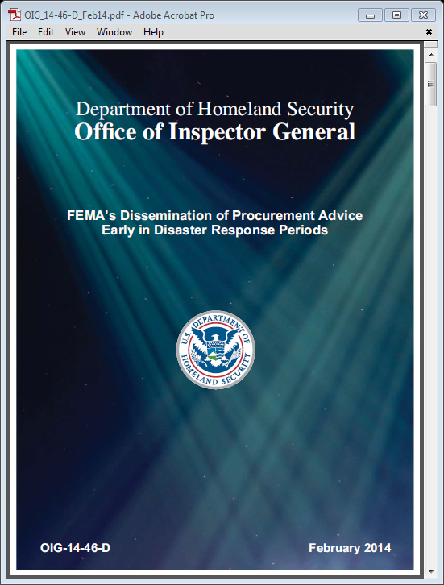
FEMA Procurement Disaster Assistance Team (PDAT)
PDAT was created by the FEMA Office of Chief Counsel in April 2014 to train and assist applicants, emergency management personnel at all levels, and FEMA personnel on the procurement rules that must be followed when contracting for work using Federal disaster assistance funds. This constitutes a large part of PDAT’s mission.

Slide 16
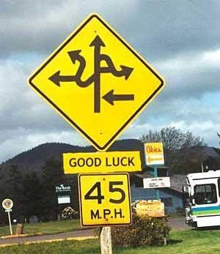
FEMA Procurement Disaster Assistance Team (PDAT)
We also assist applicants by reviewing questions from, and providing answers through FEMA personnel, as we are not
legal advisors for applicants.
We also deploy to Joint Field Offices (“JFO”) to provide support to applicants, deployed FEMA personnel, and emergency management personnel on the ground.

Slide 17
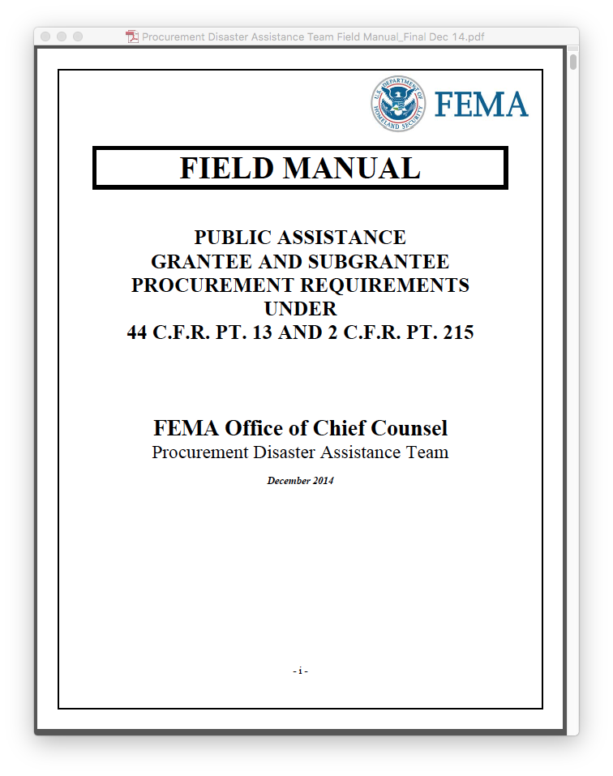
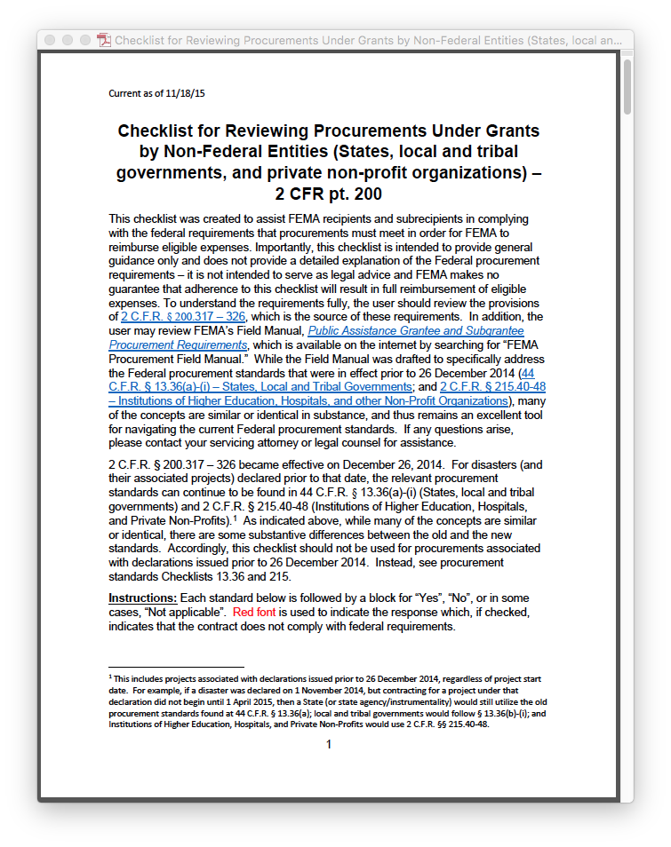
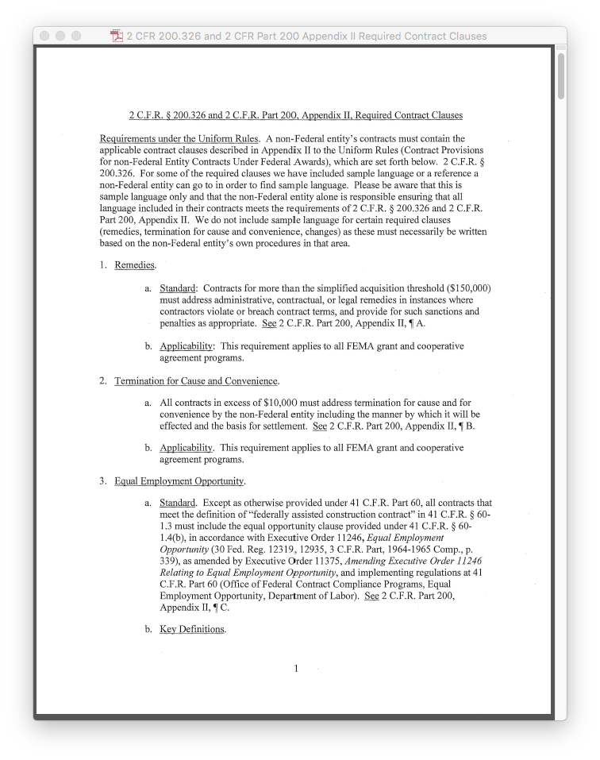



FEMA Procurement Disaster Assistance Team (PDAT)
We will provide an electronic copy of the slides to you after the conclusion of the training session.
We highly encourage you to download copies of the procurement regulations.
Please also go to: www.fema.gov/procurement-disaster-assistance-team

Slide 18

Background
Stafford Act Applicability Grace Period Contracting
The Robert T. Stafford Disaster Relief and Emergency Assistance Act (“Stafford Act”) authorizes Federal financial assistance for states, local and Indian tribal governments, and certain private nonprofit organizations to respond to and recover from emergencies and major disasters.
FEMA administers this financial assistance through various Stafford Act grant programs.
Public Assistance Program
Hazard Mitigation Grant Program
Pre-Disaster Mitigation
Notes:
Definition of Emergency and Major Disasters
Emergency: means any occasion or instance for which, in the determination of the President, Federal assistance is needed to supplement State and local efforts and capabilities to save lives and to protect property and public health and safety, or to lessen or avert the threat of a catastrophe in any part of the United States
Major Disaster: means any natural catastrophe (including any hurricane, tornado, storm, high water, winddriven water, tidal wave, tsunami, earthquake, volcanic eruption, landslide, mudslide, snowstorm, or drought), or, regardless of cause, any fire, flood, or explosion, in any part of the United States, which in the determination of the President causes damage of sufficient severity and magnitude to warrant major disaster assistance under this Act to supplement the efforts and available resources of States, local governments, and disaster relief organizations in alleviating the damage, loss, hardship, or suffering caused thereby.
Provide summary of grant programs under each
Provide overview of the enabling statutes, regulations, and FEMA policies for Public Assistance Program

Slide 19
Background
Stafford Act Applicability Grace Period Contracting
DHS adopted the Uniform Rules on December 19, 2014, in an Interim Rule (79 Fed. Reg. 75871)
The Uniform Rules apply to all new grant awards under emergencies and major disasters declared on or after December 26, 2014 (79 Fed. Reg. at 75872 and § 200.110)
The Uniform Rules, where applicable, supersede the procurement standards formerly found at 44 C.F.R. § 13.36 (applicable to States, local and tribal governments) and 2 C.F.R. pt. 215 (applicable to institutions of higher education, hospitals, and private nonprofit organizations)

Slide 20
Background
Stafford Act Applicability Grace Period Contracting
44 C.F.R. pt. 13 & 2 C.F.R. pt. 215
Procurement standards for all projects associated with emergency or disaster declarations issued before this date were found at 2 C.F.R. §§ 215.40-.48 (Institutions of Higher Education, Hospitals, and other Nonprofit organizations) and 44 C.F.R. §§ 13.36(a)-(i) (States, local and tribal governments).
2 C.F.R. pt. 200 (Uniform Rules)
Procurement standards at 2 CFR §§ 200.317-.326 apply to all projects associated with declarations and emergencies issued after this date.
Dec. 26, 2014
*Grace Period*
(2 CFR § 200.110)
Notes:
Another way to look at this for the more visually inclined:
If a project is associated with a declaration that was issued prior to Dec. 26, 2014 => use old standards
44 C.F.R. pt. 13 (States, Local and Tribal Governments)
2 C.F.R. pt. 215 (Institutions of Higher Education, Hospitals, and other private non-profits)
***Note – projects associated with a declaration prior to Dec. 26, 2014, can and will continue into the foreseeable future, e.g. projects associated with Hurricane Katrina are still being awarded and must apply the standards applicable to declarations prior to Dec. 26, 2014, even though we’re now half-way through 2016.***
If a project is associated with a declaration that was issued on or after Dec. 26, 2014 => use new/current standards
2 C.F.R. pt. 200.

Slide 21
Background
Stafford Act Applicability Grace Period Contracting
The Uniform Rules at 2 C.F.R. § 200.110 provide that:
Federal awarding agencies must implement the policies and procedures applicable to Federal awards by promulgating a regulation to be effective by December 26, 2014, unless different provisions are required by statute or approved by OMB. For the procurement standards in §§ 200.317-.326, non-Federal entities may continue to comply with the procurement standards in previous OMB guidance (as reflected in § 200.104) for a total of three fiscal years after this part goes into effect…. If a non-Federal entity chooses to use the previous procurement standards for all or part of these three fiscal years before adopting the procurement standards in this part, the non-Federal entity must document this decision in its internal procurement policies.
Notes:
Instructor’s Note: This regulation has some ambiguities.
The COFAR has issued the following FAQ in this regard:
“However, in light of the new procurement standards, for procurement policies and procedures, for the non-Federal entity’s first full fiscal year that begins on or after December 26, 2014, the non-Federal entity must document whether it is in compliance with the old or new standard, and must meet the documented standard.
For example, the first full fiscal year for a non-Federal entity with a June 30th year end would be the year ending June 30, 2016. The Single Audit Compliance Supplement will instruct auditors to review procurement policies and procedures based on the documented standard. For future fiscal years, all non-Federal entities will be required to comply fully with the uniform guidance.”
For OIG Audits and Project Close-out, you will need to ensure the applicable rules in future audits as to what procurement standards apply.

Slide 22
Background
Stafford Act Applicability Grace Period Contracting
BREAKDOWN:
What is the 2 C.F.R. pt. 200 effective date? → December 26, 2014
Who’s fiscal year is used to measure? → The applicant’s fiscal year
When do you start measuring? → The first fiscal year after the effective date
Notes:
2 C.F.R. pt. 200 Effective Date:
Dec. 26, 2014
The first additional fiscal year begins…?
Depends upon the applicant and its fiscal year.
Some applicants have:
Calendar Year – Jan. 1 – Dec. 31
July – Jul. 1 – Jun. 30
October – Oct. 1 – 30 Sept.
The second additional fiscal year begins…?
The first day after the end of the previous fiscal year…
What if we change the dates?
We’ll see in the next two slides.

Slide 23
Background
Stafford Act Applicability Grace Period Contracting
Example 1: Applicant Fiscal Year = Calendar Year
2 C.F.R. pt. 200 Effective Date → December 26, 2014
First Additional Fiscal Year (FY) →Begins on the start of the first FY after December 26, 2014, which is January 1, 2015 in this example
Second Additional FY → Same start/end dates as applicable for the first additional FY
Third Additional FY → Same start/end dates applicable for the first and second additional FYs
JAN
FEB
MAR
APR
MAY
JUN
JUL
AUG
SEP
OCT
NOV
DEC
JAN
FEB
MAR
APR
MAY
JUN
JUL
AUG
SEP
OCT
NOV
DEC
Fiscal Year 15
Fiscal Year 16
JAN
FEB
MAR
APR
MAY
JUN
JUL
AUG
SEP
OCT
NOV
DEC
Fiscal Year 17

Slide 24
Background
Stafford Act Applicability Grace Period Contracting
Example 2: Applicant Fiscal Year = Non-Calendar Year
2 C.F.R. pt. 200 Effective Date → December 26, 2014
First Additional Fiscal Year (FY) → Begins on the start of the first FY after December 26, 2014, which is October 1, 2015 in this example.
Second Additional FY – Same start/end dates as applicable for the first additional FY
Third Additional FY – Same start/end dates as applicable for the first and second additional FYs
OCT 2015
NOV
DEC
JAN 2016
FEB
MAR
APR
MAY
JUN
JUL
AUG
SEP 2016
OCT 2016
NOV
DEC
JAN 2017
FEB
MAR
APR
MAY
JUN
JUL
AUG
SEP 2017
Fiscal Year 16
Fiscal Year 17
OCT 2017
NOV
DEC
JAN 2018
FEB
MAR
APR
MAY
JUN
JUL
AUG
SEP 2018
Fiscal Year 18

Slide 25

Background
Stafford Act Applicability Grace Period Contracting
Non-Federal entities will often use contractors to help them carry out their Stafford Act awards or subawards.
For example, a non-Federal entity may receive a Public Assistance award to restore a damaged building, and then award a contract to a construction company to do the work.
The contract is a commercial transaction
between the non-Federal
entity and its contractor.
FEMA has no
contractual relationship
with the contractor, but…

Slide 26


Background
Stafford Act Applicability Grace Period Contracting
Although the Federal government is not a party to the contract, the non-Federal entity must comply with the conditions attached to a grant in awarding federally-assisted contracts.
A non-Federal entity must comply with the procurement requirements imposed by Federal law, executive orders, and federal regulations.
These will control over non-Federal authorities (such as local procurement standards) to the extent they conflict with Federal requirements.
The Uniform Rules set forth the various procurement standards at 2 C.F.R. §§ 200.317 – .326.

Slide 27

Background
Applicability Grace Period Contracting Noncompliance
Remedies for Non-Compliance with the Federal Procurement Standards:
(2 C.F.R. § 200.388)
(a) Temporarily withhold cash payments pending correction of the deficiency by the non-Federal entity or more severe enforcement action by the Federal awarding agency or pass-through entity
(b) Disallow all or part of the cost of the activity or action not in compliance
(c) Wholly or partly suspend or terminate the Federal award
(d) Initiate suspension or debarment proceedings
(e) Withhold further awards for the program
(f) Take other remedies that may be legally available
Notes:
If a non-Federal entity fails to comply with Federal laws, regulations, executive orders, and the terms and conditions of a federal award, FEMA may take certain remedies for noncompliance (2 C.F.R. §§ 200.338-339)
Potential Remedies for Noncompliance
Temporarily withhold cash payments pending correction of the deficiency by the non-Federal entity or more severe enforcement action by the Federal awarding agency or pass-through entity
Disallow (that is, deny both use of funds and any applicable matching credit for) all or part of the cost of the activity or action not in compliance
Wholly or partly suspend or terminate the Federal award
Initiate suspension or debarment proceedings (or in the case of a pass-through entity, recommend such a proceeding be initiated by a Federal awarding agency
Withhold further awards for the program
Take other remedies that may be legally available

Slide 28

Suspension and Debarment
Non-Federal Entities and contractors are subject to the non-procurement suspension and debarment regulations implementing Executive Orders 12549 and 12689, 2 C.F.R. pt. 180 (2 C.F.R. § 200.212)
Non-Federal Entities must not make any award or permit any award at any tier to parties listed on the government-wide exclusions in the System for Award Management (“SAM”), which can be found at www.sam.gov.
The rules for assistance exclusion are also governed by DHS implementing regulations at 2 C.F.R. pt. 3000.

Slide 29
Agenda
Introductory Remarks
Terminology and Key Players
Background
Procurement Standards for States
Other Considerations for State Procurements

Slide 30
Summary of Procurement Standards
State Non-Federal Entities (state agencies, instrumentalities of the state, and territories) | Other Non-Federal Entities (local governments, tribal governments, IHEs, hospitals, and other nonprofit organizations)
2 C.F.R. § 200.317 | 2 C.F.R. §§ 200.318 through 200.326
Synopsis: (1) Must follow same policies and procedures it uses for procurements from its non-Federal funds; (2) Comply with § 200.322 (procurement of recovered materials); and (3) Include any clauses required by § 200.326 (contract provisions) | Synopsis: (1) Must follow its own documented procurement procedures which reflect applicable state, local, and tribal laws and regulations; and (2) Provided that the procurements conform to applicable federal law and the standards identified in 2 C.F.R. §§ 200.318 through 200.326

Slide 31
State Definition
“State” – means
any state of the United States,
the District of Columbia, the Commonwealth of Puerto Rico, U.S. Virgin Islands, Guam, American Samoa, the Commonwealth of the Northern Mariana Islands, and
any agency or instrumentality thereof exclusive of local governments. (2 CFR §200.90)
Each NFE has to determine the status of a particular entity before contracting to determine which rules it should follow.

Slide 32
#1 States Must Follow Your Own Standards
States must ensure compliance with the policies and procedures it follows for procurements using non-Federal funds.
States must be prepared to provide FEMA with its procurement policies and procedures.
States must maintain documentation to evidence how they complied with their own policies and procedures.

Slide 33

#2 Procurement of Recovered Materials
A non-Federal entity that is a state agency or agency of a political subdivision of a state and its contractors must comply with Section 6002 of the Solid Waste Disposal Act, as amended by the Resource Conservation and Recovery Act (2 C.F.R. § 200.322)
The requirements of Section 6002 include:
Procuring only items designated in guidelines of the EPA at 40 C.F.R. pt. 247 that contain the highest percentage of recovered materials practicable, consistent with maintaining a satisfactory level of competition, where the purchase price of the item exceeds $10,000 or the value of the quantity acquired during the preceding fiscal year exceeded $10,000
Procuring solid waste management services in a manner that maximizes energy and resource recovery
Establishing an affirmative procurement program for procurement of recovered materials identified in the EPA guidelines.
Notes:
Recycling/Environmental Requirement derived from EPA

Slide 34

# 3 Required Contract Provisions
A non-Federal entity’s contracts are required to contain certain provisions – some are based on sound contracting practices while others are required by Federal law, executive order, and regulations (2 C.F.R. § 200.326). (change)
These required provisions are provided in Appendix II to Part 200—Contract Provisions for Non-Federal Contracts Under Federal Awards.
> $150k – Administrative/contractual/or legal remedies for breach of contract
> $10k – Terminations for Cause and Convenience
Equal Employment Opportunity – Construction
Davis Bacon / Copeland Anti-Kickback Acts –
Construction (Inapplicable to PA grants)

Slide 35

Required Contract Provisions
Required Contract Provisions (cont’d):
> $100k + mechanics or laborers – Contract Work Hours and Safety Act
Rights to Inventions Made Under a Contract or Agreement (Inapplicable)
> $150k – Clean Air Act & the Federal Water Pollution Control Act
Debarment and Suspension – “SAM”
> $100k award – Byrd Anti-Lobbying Amendment
§ 200.322 – Procurement of Recovered Materials

Slide 36



Hypothetical: States
The Federal procurement standard at 2 C.F.R. § 200.320(b) allows small purchase procedures for the acquisition of supplies or services below the simplified acquisition threshold (which is currently $150,000). The State of X has a threshold of $175,000 in its own version of small purchase procedures, and uses its own threshold and small purchase procedures to procure $170,000 in supplies.
Is there an issue with the State’s procurement?
Notes:
Instructor Note: We have not yet reviewed what “small purchase procedures” are. Explain that small purchase procedures are those relatively simple and informal small purchase procedures when securing services, supplies, or other property where the aggregate dollar amount of the services, supplies, or other property does not exceed the simplified acquisition threshold.
Answer: No, this is permissible. The state must follow same policies and procedures it uses for procurements from its non-Federal funds—it is not subject to the requirements of 2 C.F.R. 200.320(b).

Slide 37
Agenda
Introductory Remarks
Terminology and Key Players
Background
Procurement Standards for States
Other Considerations for State Procurements

Slide 38
Cost Reasonableness
2 CFR Subpart E – Cost Principles
State must comply with the cost principles
A cost is reasonable if, in its nature and amount, it does not exceed that which would be incurred by a prudent person under the circumstances prevailing at the time the decision was made to incur the cost
(2 C.F.R. § 200.404)

Slide 39
T&M and CPPC Rules for State Entities
The Federal procurement standards do not address the use of T&M and CPPC for states
However, states are subject to the cost principles in subpart E of 2 CFR part 200.
FEMA will scrutinize all contracts to ensure that costs are reasonable.
States should carefully deliberate whether its contract are likely to result in unreasonable costs.
T&M and CPPC contracts will be carefully reviewed by FEMA for cost reasonableness

Slide 40
Possible Issue – Time and Materials Contracts
Actual cost of materials
Loaded Labor Hours (+Profit)
Time & Materials
Consider whether or not this is the most suitable contract type; consider if there is clear scope of work
Consider including a contract ceiling that the contractor exceeds at its own risk
Monitor these contracts closely
When Time and Materials Contracts are used, there is no incentive for contracts to be cost effective and efficient. No incentive for contractor to control cost; contractor has financial interest in increasing cost of performance.

Slide 41
Possible Issue – Cost Plus Percentage of Cost Contracts
These contracts may be allowed under state law, but are generally discouraged
No incentive for contractor to control cost; contractor has financial interest in increasing cost of performance
Criteria evidencing this type of contract:
(1) Payment is on a predetermined percentage rate;
(2) The predetermined percentage rate is applied to actual performance costs;
(3) The contractor’s entitlement is uncertain at the time of contracting;
(4) The contractor’s entitlement increases commensurately with increased performance costs.

Slide 42

Questions
Additional resources can be found at the following link:
www.fema.gov/procurement-disaster-assistance-team

Slide 43


